Slide 1















De Carbify
A digital solution to carbon emission problem

Slide 2
The Team
Shreyan Panda
Vishwajeet Kumar
Vipul Singh
Sankalp Prajapati

Slide 3

Problem Statement
With technology increasingly becoming an integral part of our lives, the carbon footprint of gadgets, the internet, and the supporting systems has grown significantly, now accounting for 3.7% of global greenhouse emissions, equivalent to the airline industry. This figure is projected to double by 2025 due to the proliferation of new devices, including smart medical devices. There is an urgent need to develop solutions that can accurately calculate, track, and ultimately reduce the carbon emissions generated by these devices and data usage, in order to mitigate their environmental impact.

Slide 4
Project vision and mission
De-Carbify solves the problem by providing users with precise, actionable insights into their carbon emissions. By visualizing these emissions and encouraging responsible tech usage through goal-setting, challenges, and educational resources, De-Carbify motivates users to adopt more sustainable behaviors. The platform also curates energy-efficient products and services, directly guiding users toward greener choices.
02.
We intend to solve the problem of technology-related carbon emissions by developing
De-Carbify, an all-in-one platform that allows users to monitor, track, and reduce their carbon footprint associated with tech usage. By offering personalized dashboards, real-time carbon tracking, and gamified incentives, De-Carbify empowers individuals and businesses to make informed decisions, set carbon reduction goals, and engage in sustainable practices.
01.
De-Carbify can be implemented relatively easily by leveraging existing technology stacks and cloud services. The use of widely adopted frameworks like React.js and Node.js ensures rapid development and scalability. The platform’s effectiveness lies in its ability to engage users through gamification, providing both individual and collective incentives to reduce carbon footprints, thereby driving substantial behavioral change and measurable environmental impact.
03.

Slide 5

Metrics used to analyse the solution
Carbon Reduction: Measure the decrease in carbon emissions over time for individual users and businesses.
User Engagement: Track participation in challenges, goal completion rates, and active user growth.
Behavioral Change: Analyze shifts in tech usage patterns and adoption of sustainable practices.
Product Adoption: Monitor the purchase and usage of energy-efficient products from the marketplace.
Community Impact: Assess collective carbon reduction within communities and organizations using De-Carbify.

Slide 6

Frameworks/Tech Used
Frontend: React.js for the web app, Flutter for the mobile app.
Backend: Node.js with Express.js for server-side logic.
Database: MongoDB for scalable, NoSQL data storage.
Cloud Services: AWS or Google Cloud for hosting, data processing, and machine learning models.
Machine Learning: TensorFlow or PyTorch for carbon footprint estimation and personalized recommendations.
APIs: Integration with energy usage APIs, carbon accounting standards, and third-party sustainability platforms.

Slide 7
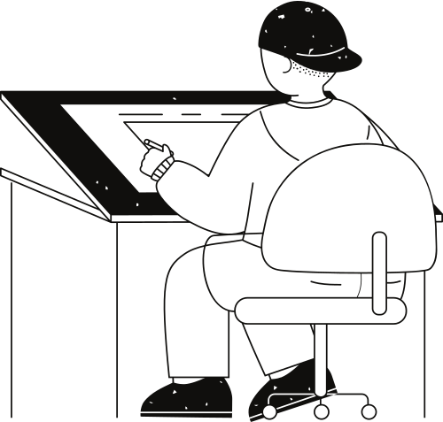




Data is collected
Predicts your carbon emission over a year
Flow Chart
Analyses your cabon emission
Fed to the model

Slide 8
87%
Accuracy
Carefully based on training and validation datasets

Slide 9

Assumptions and Constraints
Assumptions
Users have access to data on their device usage.
Energy providers and sustainability organizations are willing to collaborate.
Constraints
Ensuring user data privacy while collecting detailed usage data.
Accurately calculating carbon footprints across a wide range of devices.

Slide 10

Reflections and future scope
Advanced AI & Automation:
Enhanced personalized recommendations.
Automated device optimizations for lower emissions.
IoT & Smart Device Integration:
Real-time energy monitoring.
Seamless smart home and office control for reduced carbon usage.
Global Expansion & Partnerships:
Collaborations with governments, NGOs, and corporations.
Integration with enterprise systems for large-scale carbon tracking.
Educational & Community Initiatives:
Comprehensive sustainability education modules.
Global challenges and community-driven carbon reduction efforts.
Broader Environmental Metrics:
Track water usage, waste production, and biodiversity impact.
Localized Solutions:
Region-specific features and customization.
Multilingual and culturally adapted platform versions.

Slide 11
Thank you very much!

